Slide 1
Top 10 Lessons Learned Implementing Exadata
Oracle OpenWorld 2009
by James Madison

Slide 2
Agenda – Top 10 Lessons
Background
  About The Hartford & the speaker
  About the data warehouse platform selection
Within the Box
  1) The machine is very fast; both absolute and cost-relative
  2) With performance commoditized, the “big toolbox” wins
  3) Fundamentals still matter: parallelism, partitioning, and query tuning
Around the Box
  4) We had to promote how different Exadata is NOT
  5) Database & system tuning…leave it alone more than not
  6) The workload trinity: big database, services, and resource manager
Other Considerations
  7) Performance efficiency: disk reads versus CPU and DML
  8) Node and parallelism details continue to gain transparency
  9) Oracle corporation continues to enhance the full experience
Long Term
  10) Watch and advocate the “down the stack” trend

Slide 3
About The Hartford and the speaker
About The Hartford Financial Services Group, Inc.
  One of the nation’s largest diversified financial services companies
  Auto, home, business, & life insurance; group benefits; investments
About Oracle at The Hartford
  User of Oracle’s universal license agreement
  Several hundred Oracle databases
  ~90 TB EDW on Oracle; some Teradata, which is being retired
About James Madison
  11 years on Oracle database, working at all database levels
    Server, storage, system DBA, app DBA, data developer, modeler
    9 industry publications/awards, most involving Oracle database
  Worked on Exadata from day one
    Have worked on Exadata 2008
    Have worked on Exadata V2 since 2009

Slide 4
About the database platform selection process
2007: Program initiation
  Large-scale program to improve enterprise information management
2007: Platform project
  A critical part was a high-performance, low-maintenance platform
2008: Initial POC
  Over a dozen vendors considered, six made the list “on paper”
  POCd Oracle Optimized Warehouse and two competitors
2009: Second POC for Exadata
  When Exadata V1 became available, the POC was rerun on it
2009: Exadata wins
  Speed, price, functionality, existing code base, available skills
2009-2011: Migrate and grow
  Production at 2009 year end; to 20 TB in 2010, to 90 TB by 2011

Slide 5
Lesson #1 – The machine really is very fast; both absolute and cost-relative
Our POC achieved a 400x performance gain
  Oracle advertises a 10x performance gain – a conservative number
    But if your environment is old or sub-optimized, expect much more
  One competitor advertises 100x performance gain – a liberal number
    True, but again, depends on your environment
SATA was our drive choice
  SAS drives are faster but smaller; SATA not as fast but bigger
  We felt the size was more valuable, and still plenty fast
  Oracle also ran our POC on SAS; faster, but not enough to change
Storage offload is over 90% for our queries
  A key to Exadata is moving database functionality to storage
  How much can be queried from v$sysstat
All performance measures were cost-relative
  Dollars per query hour; see TPC-H
400x!

Slide 6
Lesson #2 – With performance commoditized, the “big toolbox” wins
“Fast” just means commodity hardware with MPP design
  For the most part, hardware is hardware
  MPP means balanced configuration & spin all the disks
All the vendors in our POC were fast enough to be viable
  To some extent, DW platform speed has become a commodity
  But what will you do with all that speed?
Database functionality now wins—need more than just speed
  Oracle outperforms others on functionality
  When speed is a commodity, functionality dominates
Scope | Features
For DBAs | Flashback, RMAN, Data Pump, ASM, many Advisors, etc.
For Developers | PL/SQL, Java, objects, merge, external files, etc.
Applications | OLAP, data mining, spatial, text analytics, etc.
And more! | Select count(*) from dba_feature_usage_statistics = 117

Slide 7
Lesson #3 – Fundamentals still matter: parallelism, partitioning, and query tuning
Parallelism can be “off” if you’re not careful
  Exadata is parallel, but parallelism must be enabled at lower levels
  Have tables and/or tablespaces use “parallel default”
  Use a logon trigger with “alter session enable parallel dml”
Partitioning should still be done rigorously
  No matter how fast Exadata is, scanning less data makes it faster
  11g has more partitioning options than ever, use them well
    Partitions should be a max of 2G compressed, 4G uncompressed
    Hash partitions should have 32 buckets or more to be useful
Database tuning is low, but queries can still be bad
  The box is a low-tuning appliance, but queries should still be tuned
  Deploy OEM to all developers and encourage use
    Visual query tree & graphically presented metrics—beats “show plan”

Slide 8
Lesson #4 – We had to promote how different Exadata is NOT
Hardware architecture is revolutionary
  CPU’s and DB functionality moved to storage
  All in one box instead of build-it-yourself
It’s “just” another Oracle database
  Above the SQL prompt, it’s just another Oracle database
    For developers, analysts, users, functionality is unchanged
  Within the enterprise, it’s just an Oracle database & server
    Found 8 “integration points” that had to work with Exadata—all did
    See diagram on next slide
The DBA team did have to do some catch-up
  Grid/RAC, ASM, RMAN were big ones
    These are still standard Oracle DB items, but Exadata forced them
Only the data center had to change their thinking a bit
  Weight of a storage array, cooling/electricity of both

Slide 9
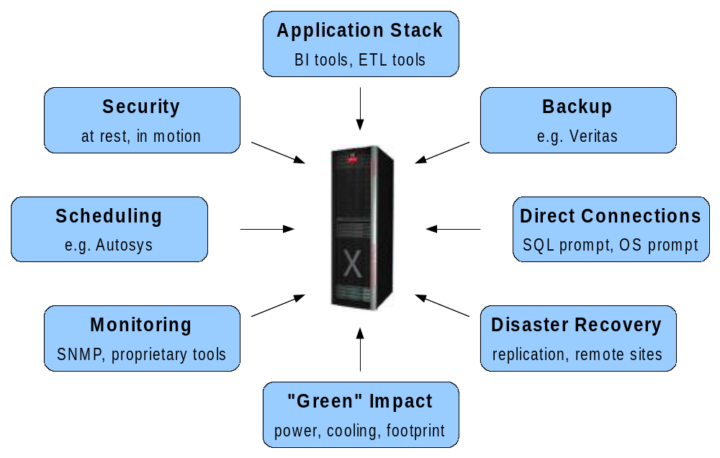
Lesson #4, continued – integration points that work with Exadata, just as with all Oracle versions

Slide 10
Lesson #5 – Database & system tuning…leave it alone more than not
Hardware level – functions as a unit, nothing to do
  Even with OOW, customers could still alter it—we changed 3 things
Linux level – largely transparent
Database level – Set the parameters shown to the right
  Most are quite straightforward
    Green = trivial (5)
    Red = tuning (10)
  All others¹ are left at defaults
  Your values may vary
  Two-node environment shown
compatible 11.1.0.7
filesystemio_options setall
nls_length_semantics CHAR
open_cursors 2000
parallel_adaptive_multi_user FALSE
parallel_execution_message_size 16384
parallel_max_servers 128
parallel_min_servers 32
pga_aggregate_target 17179869184
processes 1024
recyclebin OFF
remote_login_passwordfile EXCLUSIVE
resource_manager_plan DEFAULT_PLAN
sessions 1131
sga_target 8589934592
¹ Not shown are ones that are naturally vary by environment configuration such as control_files, cluster_database_instances, etc.

Slide 11
Lesson #6 – The workload trinity: big database, services, and resource manager
Current state
  Many little databases – big ones would get unmanageable
  Connect via one service per database – because the DB is small
  Manage resources the hard way – split databases by workload
Exadata state
  One large database¹ – the machine and backup can handle it
  Many services – to control access points, especially for DML
  Extensive resource management – to allocate power to need
Values realized
  Everything in one place, so much simpler system engineering
  Fewer databases means much less DBA management
Challenges accepted
  Upgrades and changes mean much larger coordination effort
  Outages affect a very wide customer base
¹ Per SDLC environment: development, QA, production

Slide 12
Lesson #7 – Performance efficiency: disk reads versus CPU and DML
High performance comes from read efficiency in queries
  Note: read – meaning I/O as opposed to CPU
  Note: queries – meaning SELECT statements rather than DML
CPUs intensive work may not have the lift of I/O intensive work
  Many Exadata CPUs are at the storage level
  Work that is not at the storage level uses mostly non-storage CPUs
  We had one query that was 99.9% non-I/O and had trouble
    To be fair: it was a very poor query. With fix, went from 6 hours to 2 mins
DML may not have the lift of SELECT statements
  Best practice: pin any given DML job to a node using services
  Rationale: block-level writes cannot be concurrent. Quite reasonable
  Note carefully: all nodes can be doing DML, but avoid the same DML
None of this is to say slow!!! Just not crazy-fast like reads
  Still talking about fast CPU’s, InfiniBand interconnects, lots of disks.

Slide 13
Lesson #8 – Node and parallelism details continue to gain transparency
The appliance model greatly simplifies administration
  The hardware functions as a unit
  ASM handles storage smoothly
  OEM can show many multi-node functions at once
Some node and parallelism behavior still needs to be understood
  Certain admin tasks are best done with Linux shell loops
  Some aspects of query analysis require going to specific nodes
  DML should be mapped using services
  Parallel DML must be enabled and must be committed to query
Enhancements continue; 11g R2 examples:
  Grid Plug-and-Play
  Multi-database resource management
  Degree-of-parallelism queuing – the big one

Slide 14
Lesson #9 – Oracle corporation continues to enhance the full experience
A complete data warehouse solution needs two things:
  A data warehouse appliance
  A vendor that delivers the full experience around the appliance
Some key considerations—for any vendor experience:
  Sign-and-drive contract and procurement process
  Facilitation soup-to-nuts; loading dock to retirement
  Ownership of problems throughout system lifecycle
  Management of the message at all levels of the organization
The trend is positive and clear:
  In the early years = only provided software
  Oracle Optimized Warehouse = recommended proper HW designs
  Exadata V1 = provided a complete hardware solution
  Exadata V2 = became a data warehouse hardware vendor
  Next few years = optimize all aspects of a full DW experience

Slide 15
Lesson #10 – Watch and advocate the “down the stack” trend
We cannot afford to move the data to the functionality
  Data keeps growing and growing
  We must move the functionality to the data
Oracle has been moving the functionality to the DB for years
  In-DB OLAP, in-DB mining, in-DB spatial, in-DB text, in-DB XML
Exadata moves the database to the hardware
  In-storage SELECT, in-storage WHERE, more to come
By transitivity and logical extreme: in-storage everything!
  All clauses of SELECT, bulk DML, Java, OLAP, mining, spatial, text, XML, object types, quality routines, transforms, financial functions, insurance functions, bioinformatic functions, entire application suites!
Your action items:
  Encourage your organization to move to in-DB and in-Storage
  Encourage Oracle to keep moving it down (it is on their roadmap)

Slide 16
Summary
Strong platform
  High performance
  Advanced functionality
  Low maintenance
Not mysterious or magical
  “Just” an Oracle database
  Customer knowledge matters
Solid vendor
  Industry leader
  Growing black-box service
Positioned for future
  Everything in storage!
Functionality
Speed
Vision

Slide 17
Q&A – Presentation agenda restated here for reference; other topics welcome
Background
  About The Hartford & the speaker
  About the data warehouse platform selection
Within the Box
  1) The machine is very fast; both absolute and cost-relative
  2) With performance commoditized, the “big toolbox” wins
  3) Fundamentals still matter: parallelism, partitioning, and query tuning
Around the Box
  4) We had to promote how different Exadata is NOT
  5) Database & system tuning…leave it alone more than not
  6) The workload trinity: big database, services, and resource manager
Other Considerations
  7) Performance efficiency: disk reads versus CPU and DML
  8) Node and parallelism details continue to gain transparency
  9) Oracle corporation continues to enhance the full experience
Long Term
  10) Watch and advocate the “down the stack” trend

